Slide 1
7th and 8th Grade Parent Football Meeting 2019/2020

Slide 2
Coaches Contact Information
Coach Bryan Oliver – oliverb@lisd.net
Coach Blu Bennett – bennettb@lisd.net
Coach Chris Dewbre– dewbrec@lisd.net
Coach Jim Bosker – boskerj@lisd.net

Slide 3
Non Football Participants
Expectations – 8th grade will come dressed ready to go outside at 8:50, bags will be left outside…no locker-room access. 7th grade will get dressed out during the athletic period and take their bags outside, will not be allowed into the locker room at the end of school.
Spring / Fall sports – do not play football and do not make the basketball team, then MUST run ALL cross country meets. Everyone runs Track/Field and Soccer is a cut sport.
Workouts – Aerobic and anaerobic conditioning, plyometrics, footwork and agilities, etc

Slide 4
Lamar Boys Athletics Website
http://www.lisd.net/domain/3151
ONLINE FORMS
Practice Schedules, Game Sites, Game Times, Roster Updates, Etc

Slide 5
EQUIPMENT/NEEDS
Each player will be issued a helmet, shoulder pads, integrated pants, lock and locker
Girdles / Integrated Pants – 7th White 8th Black
Football cleats, lineman should have high top cleats. We have extra cleats available.
Athletic wear – T-shirt, shorts, socks and game day shirt through LockerRoom Sports.
No jewelry of any kind, no rubber bracelets of any kind during practice or games.

Slide 6
Teams and Game Times
7th Grade (6 Min Quarters)
A Team – 7:30
B Team – 6:30
C Team – 5:30
8th Grade (8 Min Quarters)
A Team – 7:45
B Team – 6:30
C Team – 5:30 (8 min running clock quarters)

Slide 7
POST GAME INFORMATION
LISD Athlete transportation release form
Pick up point is by rear dumpsters

Slide 8
MISSING PRACTICE
If an athlete gets sick or hurt the coaching staff ask that you send a note, call, or email about their condition. A doctor’s note, with specific limitations, is required if the athlete is to miss for an extended period of time.

Slide 9
Injuries
When injuries occur we recommend that you see the trainers at Marcus, please let us know so that we can communicate with the trainers. They will evaluate the injury and let you know if they think you need to go see a doctor or if you need some therapy, which they can offer free of cost.

Slide 10
INSURANCE
Any student that is injured as the result of
participating in middle school sports is covered on a secondary basis by the policy purchased by LISD.
Parents must first file on their own insurance. The
District ‘s accident policy will only pay after the
parent(s) has filed on their own policy and submits
proof. Coach Oliver will have the forms and information if needed.

Slide 11
Parent/Coach Relationship
Appropriate concerns to discuss with a coach:
1)What your child needs to do to improve.
2)Concerns about your child’s behavior.
It is very difficult to accept your child is not playing as much or the position you hoped for. Coaches make decisions based on what they believe is the best interest of all students participating.
As you can see from the list above, certain things can and should be discussed with your child’s coach. Other things, such as those listed next, must be left to the discretion of the coach.
Issues NOT appropriate for discussion with your child’s coach:
1)How much playing time each athlete is getting.
2)Team strategy.
3)Play calling.
4)Any situation that deals with other student-athletes
There are situations that may require a conference between the coach and parent. These are not discouraged, as it is important for each party to have a clear understanding of the other’s position. When these conferences are necessary, the following procedure is suggested to help promote resolution to the issue.

Slide 12
Continued
There are situations that may require a conference between the coach and parent. These are not discouraged, as it is important for each party to have a clear understanding of the other’s position. When these conferences are necessary, the following procedure is suggested to help promote resolution to the issue.
1)Call the coach or email to set up an appointment – NO Parents allowed in the locker-room at any time
2)Think about what you expect to accomplish as a result of the meeting.
3)Stick to discussing the facts, as you understand them.
4)DO NOT confront a coach before, during, or after a practice or contest. These can be emotional times for both the parent and coach. Meeting of this nature do not promote resolution of the situation, but often escalate it.
We prefer to talk to the athlete before any parent meetings are set up. We feel like this is a very important age for the girls to learn to be a self-advocate.
Please follow the proper Chain of Command
1)Player to Coach
2)Parent to Specific Coach
3)Parent to Athletic Coordinator
4)Parent to Principal
5)Parent to HS Coach
6)Parent to MS Athletic Director – Coach Cody
7)Parent to LISD Athletic Director – Coach Ford

Slide 13
ELIGIBILITY
An athlete that fails a class at the end of the nine
weeks grading period will become ineligible to play
in game competition for three weeks. During this
time they are expected to participate in all practices.
If at the end of the three week period ALL grades are
passing, they will be allowed to compete on the date
specified by the TEA/UIL Eligibility Calendar.

Slide 14
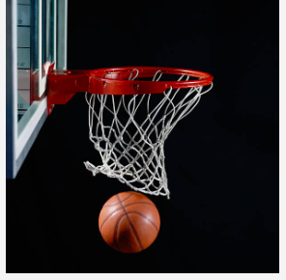
LAMAR MIDDLE SCHOOL 7TH AND 8Th GRADE BOYS BASKETBALL PARENT INFORMATION

Slide 15
Basketball 2020
Basketball is our first cut sport. This means not all athletes that tryout will make a team.
7th Grade – Div. I, Div. II, Div. III (Around 38 Kids)
8th Grade – Div. I and Div. II. (Around 22 Kids)
The athletics website will provide a packet with a practice calendar, schedule of games, game meal information, and all travel info.

Slide 16
Coaches
8th Grade
Div. I – Coach Bennett
Div. II – Coach Bosker
7th Grade
Div. I – Coach Oliver
Div. II and Div. III – Coach Dewbre

Slide 17
Equipment
*Please do not buy new basketball shoes until tryouts are over.
Students provide their own basketball shoes and are required to have black shorts for practices and games.
Practice jerseys and game jerseys are provided.

Slide 18
Basketball Practice
8th Grade Basketball Practice is in the morning.
7th Grade Basketball Practice is in the afternoon.
There will be a detailed practice calendar made availiable so you can plan ahead. This calendar will be made monthly and updated weekly.

Slide 19
MISSING PRACTICE
If an athlete gets sick or hurt the coaching staff ask
that you send a note, call, or email about their condition. A doctor’s note, with specific limitations, is required if the athlete is to miss for an extended period of time.

Slide 20
Missing Games
If you miss a game for a club sport or anything OUTSIDE of LISD activities the player will sit out what they missed.
For example: If a player misses a game on Monday they will sit on the bench and not play the next game.
Illness and Bereavement do not count.

Slide 21
Basketball Games
7th Grade Games are on Monday Nights.
-Div. III 5:30, Div. II 6:30, Div. I 7:30
8th Grade Games are on Thursday Nights.
-Div. II 5:30, Div. I 6:30
Game schedules can be found on the website later in the school year.

Slide 22
GAME DAY
The boys are required to ride the bus to all basketball games.
The boys will sit together in the bleachers until their game begins.
We will have game day meals during the basketball season.
Parents are welcome to sign their son out after they are finished for the night.

Slide 23
CROSS COUNTRY
Practices take place during the athletic period
Meets are on Wednesdays
No cuts
Meet schedule is on athletics website
Coach Montano is the head coach

Slide 24
LAMAR MIDDLE SCHOOL 7TH AND 8Th GRADE BOYS Track PARENT INFORMATION

Slide 25
Track 2020
There are NO CUTS in Track. That does not mean that everyone will get to go to a track meet. All middle schools are allowed to enter four students in each event and one team of 4 members in the relays. The selection is based on the best times, distances or measurements in the events at practice and in the previous track meets.
The athletics website will provide a packet with a practice calendar, schedule of meets, order of events, and other info.

Slide 26
Equipment
Students should provide their own track shoes and sweats for meets (with names on them). We provide their uniform. If your son WANTS to run/jump in spikes we do not provide that as they are NOT required. They will only wear spikes for meets because at Lamar our track and runways are concrete.

Slide 27
Track Practice
Running Events – before school 8:00am
Field Events – after school until 4:45pm
Pole Vault – after school at Marcus High School

Slide 28
Meets
Field events start at 4:30, track events at 5:30
Make sure you pay attention to the order of events that is printed on the back of the meet schedule
A meet schedule can be found on the website later in the school year.

Slide 29
MEET DAY
The boys will take a bus to the location for the meet.
The boys will sit together in the bleachers unless they are competing.
We encourage the boys to bring light HEALTHY snacks for between events. They should not be eating candy and junk food.
Parents are welcome to sign their son out after they are finished for the night.

Slide 30
7th & 8th Grade Soccer
Coaches – Coach Dewbre & Coach Bosker
Try-outs will begin when Track season is over, 2-3 days of Try-outs.
If they make the Team they will be given a game schedule and a Transportation Release form.
Non-soccer will be in offseason

Slide 31
7th & 8th Grade Soccer
There will be no Game Day meals for soccer, they will need to bring food or have food brought to the office by 4:00 PM.
Equipment needs – Soccer Cleats & Shin Guards
Please Do NOT buy new Soccer cleats until tryouts are over.

Slide 32
7th & 8th Grade Soccer
Games will be at 5:30 7th grade & 6:30 8th grade.
If a Transportation Release form is not filled out, the student will ride the bus back to school. Pick up will be by the rear dumpsters.

Slide 33
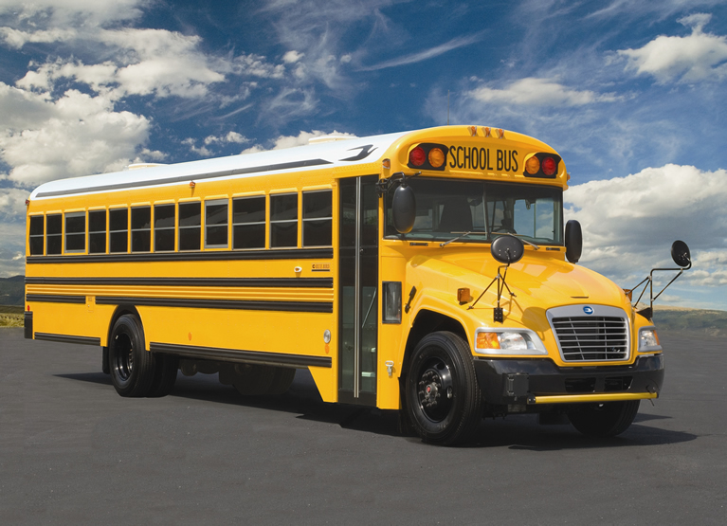
BUS
Team travel will be accomplished in school buses.
Parents are allowed to take their athlete home from a sporting event only if they sign out with a coach.
Parents will not be allowed to take home athletes
that are not their child, unless prior approval has been given by Mrs. Casal.

Slide 34
QUESTIONS?

